Slide 1
KYBERSWAP
UX AUDIT REPORT
AUGUST2023
HIGH LEVEL EXPERT REVIEW – Heuristic Evaluation & User interviews

Slide 2
1. INTRODUCTION - What we did
Executive Summary
Goals and objectives
2. METHODOLOGY- Process and Methods
Nielsen's Heuristic Evaluation
Ben Shneiderman’s 'Eight Golden Rules of Interface Design
Arnold Lund's 34 Usability Maxims
Norman's Theory of Action
Web3 Design Audit Checklist Based on Web3 Design Principles by Beltran
3. FINDINGS - What we tested on
Recommendations
4. INSIGHTS AND NEXT STEPS - What we tested on
Recommendations
⎼ In this report

Slide 3
INTRODUCTION

Slide 4
PRODUCT OVERVIEW
KyberSwap allowed users to swap and trade a wide range of Ethereum-based tokens directly from their wallets without the need for an intermediary or centralized exchange. The platform leveraged the liquidity provided by the Kyber Network to offer competitive and real-time token exchange rates.
CONTEXT OF THE AUDIT
This study involved collecting a rich research database consisting of detailed observations and findings which includes recordings of the most insightful user interviews conducted during the research process. These valuable resources complement and support the findings presented in this report.

Slide 5
METHODOLOGY

Slide 6
METHODOLOGY
This report summarizes the findings of a comprehensive UX audit conducted on KyberSwap platform.
The audit utilized a combination of renowned UX methodologies, including Nielsen's Heuristic Evaluation, Ben Shneiderman’s 'Eight Golden Rules of Interface Design, Arnold Lund's 34 Usability Maxims, Norman's Theory of Action, and the Web3 Design Audit Checklist Based on Web3 Design Principles by Beltran.
The purpose of the audit was to assess the user experience and identify areas for improvement to enhance usability and overall satisfaction

Slide 7
ISSUES SEVERITY SCALE
Critical
Severely impairs the use of the product and cannot be overcome by users. It is necessary to fix this before releasing the product..
Serious
Occurs frequently and persistently, or users may not be able to resolve the issue or may not be aware of it. It's important to fix this, so give it a high priority..
Medium
May occur more often or be harder to overcome. Fixing this should be a low release priority.
Low
Can be easily overcome by the user or occurs very rarely. The release does not require repair unless additional time is available.

Slide 8
FINDINGS

Slide 9
BUSINESS GOALS
Decentralized Exchange: KyberSwap aimed to be a leading decentralized exchange (DEX) that allowed users to trade a wide variety of ERC-20 tokens directly from their wallets without the need for intermediaries or centralized exchanges.
Liquidity Aggregation: As a part of the Kyber Network ecosystem, KyberSwap contributed to aggregating liquidity from various sources, including Kyber's reserve managers and other liquidity providers. By pooling liquidity, KyberSwap aimed to ensure competitive rates and efficient trades for users.
User-Friendly Interface: KyberSwap focused on delivering a user-friendly and intuitive platform that made it accessible to both cryptocurrency beginners and experienced traders.
Ecosystem Integration: KyberSwap worked on integrating with various decentralized applications (dApps), wallets, and other platforms within the blockchain ecosystem.
Decentralized Finance (DeFi) Growth: KyberSwap actively participated in the DeFi space and supported various DeFi projects and initiatives. By facilitating token swaps for DeFi tokens, KyberSwap aimed to contribute to the growth and adoption of DeFi applications and protocols.

Slide 10
CUSTOMER GOALS
Easy Token Swaps: Simplify the process of token swapping for customers by offering a user-friendly interface. KyberSwap aimed to make it quick and straightforward for users to exchange one ERC-20 token for another without the need for complex trading mechanisms.
Non-Custodial Security: Provide customers with a secure trading environment by being a non-custodial DEX. KyberSwap allowed users to connect their Ethereum wallets directly to the platform, ensuring that users retained full control of their private keys and funds throughout the trading process.
Access to a Wide Range of Tokens: Offer customers access to an extensive selection of ERC-20 tokens for trading. KyberSwap aimed to support popular tokens as well as emerging ones, ensuring that customers could easily swap their desired assets without needing to visit multiple exchanges.
Competitive Rates: Ensure competitive token exchange rates for customers by aggregating liquidity from various sources within the Kyber Network ecosystem. By having access to multiple liquidity providers, KyberSwap aimed to provide customers with optimal rates and minimize slippage.
Transparent and Instant Transactions: Deliver transparency and speed in token swaps. KyberSwap sought to provide real-time information about token prices and execute trades swiftly to enhance the customer experience.

Slide 11
FINDINGS
Heuristic Used
Select the appropriate heuristics principle that matches the usability issue you’ve identified.
Severity
From the severity scale, select the appropriate rating for the usability issue you’ve identified.
Issue and Recommendation
Describe the usability issue and spell out your recommendations for UX improvements.

Slide 12
TASK ORIENTATION AND SITE FUNCTIONALITY
People go to web sites to achieve particular goals, not to look around and admire the design. This means web pages needs to support customer tasks. A site is task oriented when it supports users in the effective and efficient completion of their tasks.

Slide 13
Issue (LOW)
Recommendations
The current platform fails to meet the crucial UX design principle of being free from irrelevant, unnecessary, and distracting information, which significantly hampers the overall user experience. The presence of extraneous content creates confusion, overwhelms users, and detracts from the platform's primary purpose, leading to a less effective and frustrating user journey
Identify and remove any distracting elements, such as excessive animations, auto-playing videos, or irrelevant pop-ups. These distractions disrupt the user's focus and create a negative user experience.

Slide 14
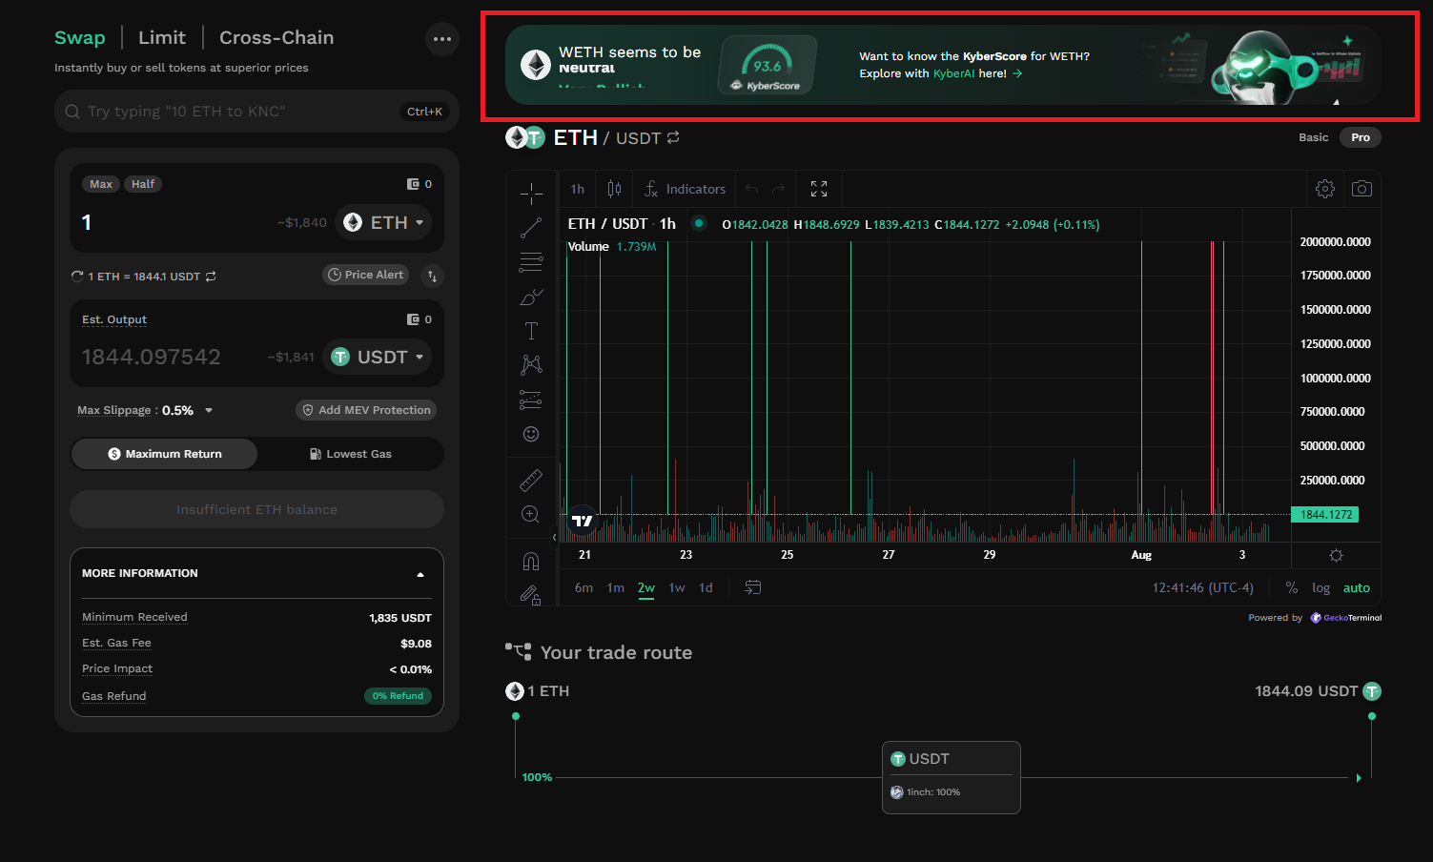
Presence of extraneous content creates confusion, overwhelms users, and detracts from the platform's primary purpose,

Slide 15
NAVIGATION AND INFORMATION ARCHITECTURE
System or mechanism that allows users to move through different sections, pages, or features of a digital product. It includes menus, links, buttons, search bars, and other interactive elements that help users find and navigate to desired content or perform specific actions. Effective navigation design ensures that users can easily understand and access different areas of the product, enhancing usability and user satisfaction.
Information architecture (IA) involves the organization and structure of information within a digital product to facilitate efficient and intuitive access. It focuses on grouping and categorizing content in a logical and meaningful manner, ensuring that information is well-organized, easily discoverable, and understandable to users

Slide 16
Issue (LOW)
Recommendations
This absence of visual feedback in “some” parts of the platform features creates confusion for users, making it difficult for them to identify interactive elements, resulting in a frustrating and unintuitive user experience.
Apply hover states to “all” clickable elements such as buttons, links, and interactive components. When the mouse hovers over these elements, provide a clear visual change, such as color change, underline, or subtle animation, to indicate their interactive nature.
Ensure that hover states are consistent across the platform. All clickable elements should exhibit a similar response when hovered over, creating a sense of familiarity and predictability for users.

Slide 17
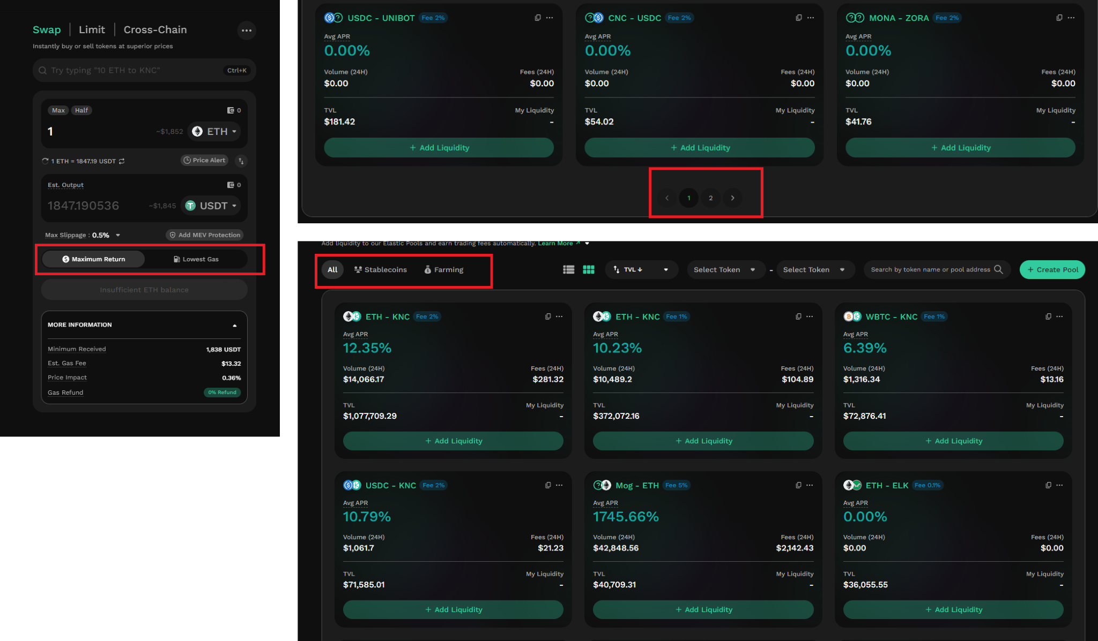
Absence of visual feedback in “some” parts of the platform features creates confusion for users, making it difficult for them to identify interactive elements asides from cursor changes.

Slide 18
SEARCH USABILITY
Search is one of the dominant ways that many customers interact with web sites. A good search engine needs to acknowledge the 'human' side of searching, which means dealing with spelling errors and synonyms (such as 'laptop' for 'notebook'). Google has set the standard for how search should look and behave, and many of these guidelines are based on this best practice.

Slide 19
Issue (LOW)
Recommendations
The search results page does not clearly indicate the number of retrieved results. Providing the number of retrieved results enhances transparency and assists users in gauging the relevance of their search queries
The current platform fails to provide a more powerful search interface to help users refine their searches effectively, which significantly impacts the overall user experience. The absence of a user-friendly "revise search" or "refine search" feature hinders users' ability to find specific and relevant content.
Clearly indicate the number of retrieved results on the search results page to provide users with an understanding of the search result scope and quantity
Introduce a prominent "revise search" or "refine search" feature that allows users to adjust and narrow down their search criteria. This advanced search option should be easily accessible from the search results page and offer a variety of filter options.

Slide 20
Issue (LOW)
Recommendations
The current platform lacks the functionality to allow users to set up complex searches and save them for regular execution, significantly impacting the user experience. This absence of a feature to save and execute custom searches prevents users from staying up-to-date with dynamic content efficiently, leading to frustration and reduced user engagement.
Users are unable to understand the boundaries of the search results, leading to confusion and frustration when attempting to find relevant information.
Implement a user-friendly feature that allows users to create and save complex searches based on their specific criteria. This feature should enable users to define various search parameters and save them for future use.
Clearly communicate the scope of the search on the search results page. Include information about the searched content, databases, or categories covered by the search to provide users with a clear understanding of what the results encompass.

Slide 21
TRANSPARENCY OF DATA PROVENANCE
Does the application clearly indicate which data comes from the blockchain and which does not?
Are the addresses of the contracts clearly stated?
Are all blockchain data linked to independent blockchain explorers?
Is it clear which data comes from oracles?

Slide 22
Issue (LOW)
Recommendations
The platform does not provide clear indications regarding the origin of data from oracles.
Enhance Oracle Data Transparency: Clearly disclose the sources of data obtained from oracles

Slide 23
TRANSPARENCY OF TRANSACTIONS
Are irreversible actions clearly indicated?
Are actions involving money or value clearly indicated?
Are actions that could potentially lead to user identification clearly indicated?
Are actions that generate new contracts in the user's name clearly indicated?
Does the application clarify and confirm the new future state in advance?
Is the data being used for a transaction shown in a human-readable format?
Are suggested values for gas price clarified and how to overwrite the transaction?
Is transaction wait time managed effectively?

Slide 24
Issue (LOW)
Recommendations
The platform does not provide clear indications for actions that are irreversible. Users are not adequately informed about the irreversible nature of certain actions, which can result in accidental or unintended actions that cannot be undone or reversed.
Fails to clearly indicate actions that could potentially lead to user identification. This lack of clarity raises significant concerns regarding user privacy and data protection.
Improve User Identification Disclosure: Clearly indicate any actions or processes that may result in user identification, ensuring users are informed about the potential risks and implications
Where feasible, offer options for users to undo or recover from irreversible actions. This can include providing an undo feature, a backup mechanism, or a recovery process that allows users to revert back to a previous state or restore lost data.

Slide 25
TRANSPARENCY AND ACCESSIBILITY OF USER’S INTERACTION HISTORY
In a future where we interact with hundreds or thousands of Dapps, tokens and probably chains, it makes sense for the user to have a clear history logged of her interactions with each one for future reference.
Does the application provide a history of all transactions from a given address?
Is it clear where the history is stored (local or server)?
Are tools provided to navigate, search, export, and delete the history cache?

Slide 26
Issue (MEDIUM)
Recommendations
The platform does not provide clear indications of where the user's history is stored, whether it is stored locally on the user's device or on the server. This lack of clarity can lead to user confusion and concerns regarding data privacy, accessibility, and potential data loss.
Clearly communicate to users whether their history is stored locally on their device or on the server. This can be achieved by providing explanatory text or tooltips that detail the storage location and the implications associated with it, such as data synchronization or potential limitations.

Slide 27
TRANSPARENCY OF CODE
Is it clear which blockchain is being used?
Are the addresses of the Smart Contracts used in read/write operations clarified?
Is it clear which code is open source and where to find it?
Is it clear where code is being run (local vs remote server)?
Is the web3 provider / Blockchain node clarified?

Slide 28
Issue (MEDIUM)
Recommendations
The platform does not clearly indicate whether the code is being run locally on the user's device or on a remote server.
The platform does not make it clear which data originates from oracles or has been influenced by oracles.
Clearly communicate whether the code is executed locally or on a remote server, addressing concerns related to data privacy, security, and external dependencies.
Clearly indicate when data is sourced from or influenced by oracles. This transparency will empower users to differentiate between data from different sources.

Slide 29
Human Readable Hashes format
Are compact versions of the hashes shown but always showing the initial and end parts?
Are users allowed to expand the full address/hash?
Can users easily copy it?
Is a custom human readable name or text associated with the addresses and hashes?

Slide 30
Issue (MEDIUM)
Recommendations
Kyber swap fails to provide users with the ability to expand the full address/hash. This limitation inhibits users from accessing and reviewing complete details.
Expandable Address/Hash Display: Allow users to expand the full address/hash to view and copy the complete details. This feature will empower users to access the necessary information and ensure accuracy in their interactions.

Slide 31
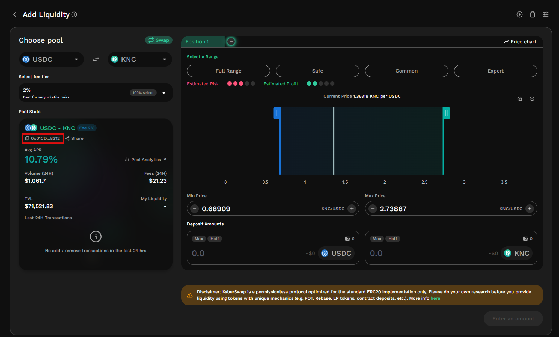
Users should be able to expand and see full address.

Slide 32
GAS PRICE AND TRANSACTION REVERSAL
Is what Gas and Gas price clarified?
Are gas prices ranges suggested and time approximations for the upper and lower bounds clarified?
Are transaction reversals allowed?

Slide 33
Issue (SERIOUS)
Recommendations
Transaction Reversals: The platform does not allow for transaction reversals. This limitation can be problematic if users make unintended or erroneous transactions.
Transaction Reversal Mechanism: Introduce a mechanism for transaction reversals, allowing users to undo unintended or erroneous transactions. This feature will enhance user control, reduce anxiety, and provide a safety net for potential mistakes.

Slide 34
USABILITY SCORE

Slide 35
195/213
EXCELLENT
This Platform provides an excellent user experience for users. Users should be able to complete all important tasks on the site or system.
USABILITY SCORE
Ultimately, the usability score is a quantitative or qualitative representation of how usable and effective a product is in meeting user needs and goals. It helps evaluate the success of UX design and identify areas for improvement to enhance the overall user experience.
Check out full usability report

Slide 36
NEXT STEPS

Slide 37
NEXT STEPS
Suggestions to improve the Curve experience
#1
Incorporate Newbies in Product Roadmap - Switch from focusing on product development for just veteran users of Curve and involve newbie users in developing a user-centric product.
#2
Implement Findings - follow up the Implementation of the Research Findings on live platform

